Slide 1
Apache Samza
She Zhaochen

Slide 2
Concept

Slide 3
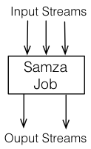
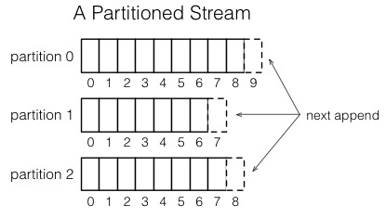
Samza Concept
‘I’
‘am’
‘fine’
Stream
Sequence of immutable messages
Job
Perform logic transformation on input messages and append them to output stream, like bolt in Storm
Partition
Each stream is divided into one or more partitions

Slide 4
Samza Concept
Job
Samza provides a API for writing jobs(StreamTasks)
Similar to bolts in Storm
public interface StreamTask{
void process(
IncomingMessageEnvelope msg,
MessageCollector collector,
TaskCoordinator coordinator
);
}

Slide 5
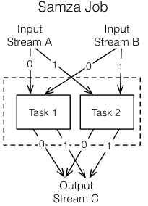
Samza Concept
Task
A job is break into tasks to increase the parallelism
Number of tasks in a job is determined by the number of input streams’ partitions
Partition-task mapping never changes.

Slide 6
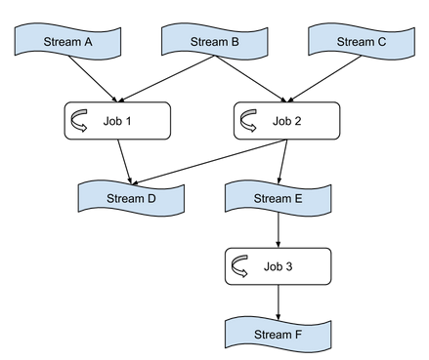
Samza Concept
Application
Compose jobs and streams to a DAG
Like topology in Storm
(Samza provides a high-level API for writing Application)

Slide 7
Samza Concept
Stream A
Containers
Partitions and tasks are logical units of parallelism. Containers are the unit of physical parallelism.
A container is a essentially a Unix process(or Linux cgroup).
Each container runs one or more tasks.
Job
Container
Container
Task1
Task2
Task3
Stream B

Slide 8
Samza Architecture

Slide 9
Architecture
Samza is combined with two other systems: Kafka and YARN
Kafka is a streaming system
YARN is a cluster resource managing system
Samza uses streams provided by Kafka to deliver messages
Samza uses physical resources (CPU, memory) on cluster provided by YARN to do the processing
Similar to the Hadoop Map-Reduce
Samza
Kafka
YARN
MapReduce
HDFS
YARN

Slide 10
Kafka
‘A1’
1
‘A3’
2
‘A5’
3
‘A6’
‘A2’
1
‘A4’
2
Kafka is a pub-sub message stream system
In Kafka, each stream is divided into one or more partitions
Each partition consists of an ordered sequence of messages
Each message has an offset which indicate its position in the sequence
Messages will not be removed after reading
‘A1’
1
‘A3’
2
‘A5’
3
‘A8’
‘A2’
1
‘A4’
2
‘A6’
3
‘A1’
1
‘A3’
2
‘A5’
3
‘A2’
1
‘A4’
2
‘A6’
3
‘A8’
4

Slide 11
Samza and Kafka
Samza
Kafka stream
Code
Kafka stream
Code
Code

Slide 12
YARN
YARN is the cluster resource manager in HADOOP
Allocate containers(computing resources) to applications
Three main components:
Resource Manager (RM)
Node Manager (NM)
Application Master (AM)

Slide 13
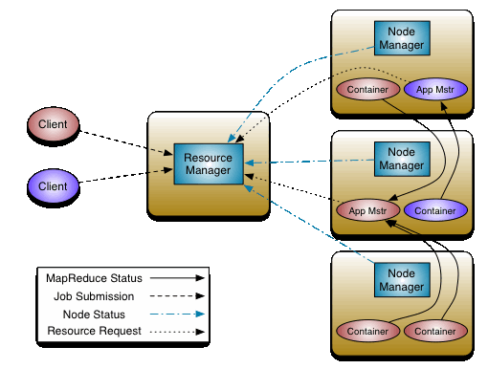
YARN
Resource Manager
One per cluster
Schedule all resources in cluster to applications
Monitor all nodes in the cluster
Node Manager
One per node
Run and monitor containers
Report status to Resource Manager
Application Master
One per application
Negotiate resources from Resource Manager
Determined what to run in each container
As a part of the application, implemented by users(not YARN)

Slide 14

Samza and YARN
ResourceManager
One Samza job is running as a YARN application in YARN cluster
NodeManager
NodeManager
Each Samza job has their own application master
Samza AM
Samza
Container
Samza
Container
Samza
Container
YARN will allocate containers to the job and run it in these containers
Kafka
Kafka

Slide 15
Example Application

Slide 16
Example Application
PageViewEvent Stream
PageViewEvent
Some users view your profile in LinkedIn
Want to know information about these viewers
Job title, company, …
Stateful processing!
{viewId: 1234}
Samza
PageViewEvent with ViewProfile

Slide 17
Example Application
PageViewEvent Stream
PageViewEvent
Some users view your profile in LinkedIn
Want to know information about these viewers
Job title, company, …
Need access the user profiles database
{viewId: 1234}
get: 1234
Samza
Profiles
{jobTitle: ‘…’}
PageViewEvent with ViewProfile

Slide 18
Example Application
PageViewEvent Stream
PageViewEvent
Some users view your profile in LinkedIn
Want to know information about these viewers
Job title, company, …
Need access the user profiles database
{viewerId: 1234}
get: 1234
Samza
Profiles
{jobTitle: ‘…’}
{viewerId: 1234, jobTitle: ‘…’}
PageViewEvent with ViewProfile

Slide 19
Example Application
PageViewEvent Stream
High throughput on input stream
Low throughput on DB
Access remote DB is too slow!
~100-500K msg/sec
Samza
Profiles
~1-5K msg/sec
PageViewEvent with ViewProfile

Slide 20
Throughput
PageViewEvent Stream
High throughput on input stream
Low throughput on DB
Cache the DB locally!
High throughput stateful processing
Samza
Profiles
Cache
PageViewEvent with ViewProfile

Slide 21
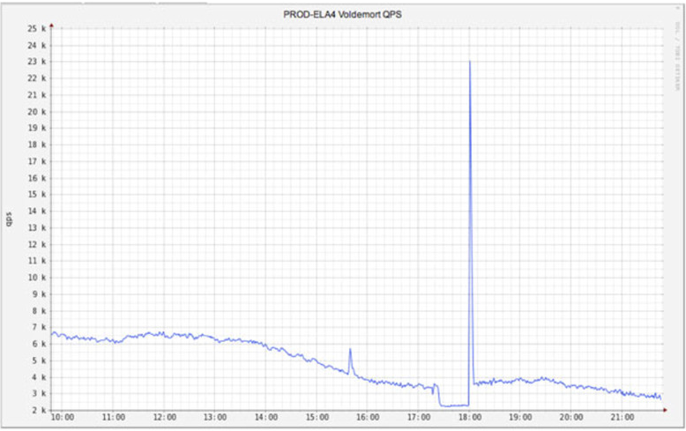
Problem here!

Slide 22
Throughput
One job with burst throughput using up DB resources
Example: one job return from a half-hour maintenance and try to catch up as fast as they can
Harms other jobs!
PageViewEvent Stream
Samza
Profiles
Cache
Too Busy!
PageViewEvent with ViewProfile
v
v
OtherJob
OtherJob

Slide 23
Better Design
Samza
Kafka stream
Code
Kafka stream
In Samza, one job can join multiple input streams
Code
Code

Slide 24
Better Design
ProfileEditEvent Stream
ProfileEditEvent
jobTitle changes, company changes, …
Make a copy of DB and modify it
Not share this DB with others
{profileId: 1234, old:{…}, new:{…}}
Set 1234, {…}
Profiles
(Our Copy)
Samza

Slide 25
Better Design
PageViewEvent Stream
ProfileEditEvent Stream
Combine with PageViewEvent
{profileId: 1234, old:{…}, new:{…}}
Set 1234, {…}
Profiles
(Our Copy)
Samza

Slide 26
Better Design
PageViewEvent Stream
ProfileEditEvent Stream
Combine with PageViewEvent
{viewId: 1234}
get: 1234
Profiles
(Our Copy)
Samza
{jobTitle: ‘…’}
{viewerId: 1234, jobTitle: ‘…’}
PageViewEvent with ViewProfile

Slide 27
Better Design
PageViewEvent Stream
ProfileEditEvent Stream
Embedded the DB in Samza!
Samza
Profiles
PageViewEvent with ViewProfile

Slide 28
Better Design
Kafka stream
Samza
Kafka stream
Embedded database(Rocks DB)

Slide 29
Fault Tolerance

Slide 30
Fault tolerance
Kafka stream
Samza
Kafka stream
Boom!!
One task dead

Slide 31
Fault tolerance
Kafka stream
Samza
Kafka stream
Lose data in old task!
Start a new one

Slide 32
Fault tolerance
Changelog of Profiles
Oldest events
Recent events
…
New events adading to here
…
…
Complete history is stored in a changelog stream(using Kafka)!

Slide 33
Fault tolerance
Changelog of Profiles
Oldest events
Recent events
…
New events adading to here
…
…
Last read event here
Start from here
Re-process historical events to recover the local DB

Slide 34
Changelog
Use lots of space if recording everything
The time of recovery is related the amount of events in history which is huge

Slide 35
Changelog
Changelog compaction by Kafka
Key-value messages
A
42
B
13
A
45
C
21
A
43

Slide 36
Changelog
Changelog compaction by Kafka
Key-value messages
A
42
B
13
A
45
C
21
A
43
Compaction
B
13
C
21
A
43
Keep only the most recent value of any given key. Remove old values.

Slide 37
Changelog
Kafka stream
Samza
Kafka stream
Kafka changelog
Write to not only DB, but also to the changelog

Slide 38
Changelog
Kafka stream
Samza
Kafka stream
Kafka changelog
Use changelog to reconstruct the DB when failing

Slide 39
Changelog
With changelog, Samza can restart multiple jobs in parallel
Faster recovery from failures

Slide 40
More details

Slide 41
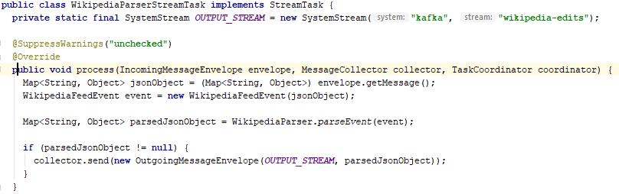
Job and Application Example
Samza provides a API for writing jobs(StreamTasks)

Slide 42
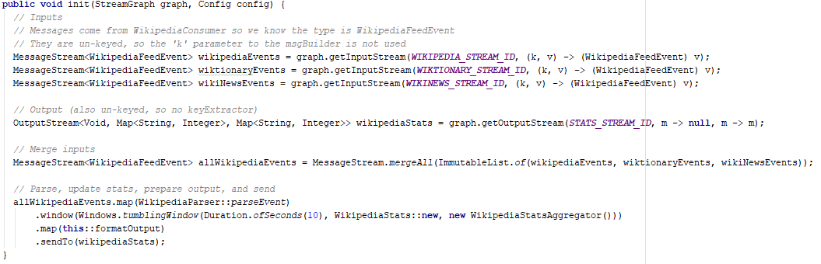
Job and Application Example
Samza provides a high-level API which has pre-defined operators in recent version for writing applications
en-wikipedia
formatOutput
mergeAll
WikiParser
window
en-wiktionary
wikipedia-stats
en-wikinews

Slide 43
Submission of a Samza job
Setup Kafka server and YARN cluster if they are not existing
Package the application’s code with its dependencies
Upload the application package to somewhere reachable from the YARN cluster
YARN will download this package for running the application
Use the Samza client to submit the job with some configurations to the YARN cluster as a YARN application
In YARN cluster, the AM implemented by Samza will run and manage the job accordingly.

Slide 44
Submission of a Samza job
Local Machine
HDFS
Cluster
User’s code
Samza environment
Samza Application pacakge
YARN
Cluster

Slide 45
Submission of a Samza job
Local Machine
HDFS
Cluster
Samza environment
Samza Application pacakge
Samza Application pacakge
YARN
Cluster

Slide 46
Submission of a Samza job
Local Machine
HDFS
Cluster
Run-application.sh
Samza environment
Samza Application pacakge
YarnApplication
ApplicationMaster
Samza Application pacakge
YARN
Cluster

Slide 47
Submission of a Samza job
Local Machine
HDFS
Cluster
Samza environment
Samza Application pacakge
YarnApplication
ApplicationMaster
Samza Application pacakge
YARN
Cluster

Slide 48
Submission of a Samza job
Local Machine
HDFS
Cluster
Samza environment
Samza Application pacakge
Samza Application pacakge
YARN
Cluster
YarnApplication
AM
Container

Slide 49
Submission of a Samza job
Local Machine
HDFS
Cluster
Samza environment
Samza Application pacakge
Samza Application pacakge
YARN
Cluster
YarnApplication
Container
Container
AM
Task
Task

Slide 50
Thanks for listening

